Slide 1
NATs
Module 14 - Chapter 6

Slide 2
Introduction
NATs appear in Round 3 and beyond
To use NATs you will need to know basic ACL configuration
I will be doing that part of today’s lesson
NATs are generally worth 10-15 points in Round 3 and generally increase in point value in Semi-Finals (I unfortunately do know know about the National Round)

Slide 3
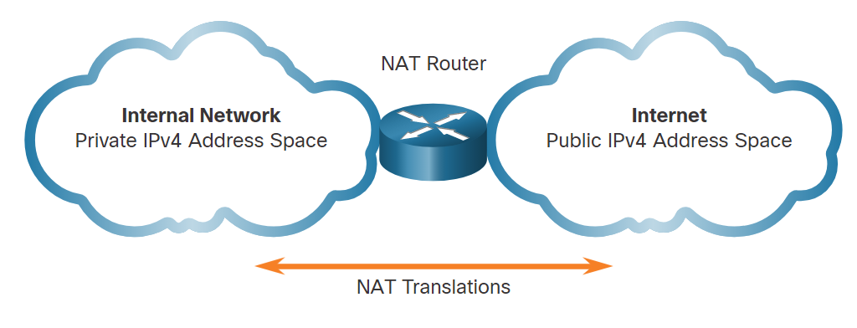
What is a NAT (Network Address Translation)
Limited public IPv4 addresses so devices use private IPv4 addresses
Private IPv4 addresses must be translated to public for access to the Internet

Slide 4
Static NAT
Dynamic NAT
Uses one-to one mapping
Converts inside local addresses to inside global addresses
Requires that there be enough addresses to fulfill the number of simultaneous users at any given time
Uses a pool of public addresses (ACLs)
Addresses are assigned on a first come first serve basis
Requires that there be enough address to fulfill the number of simultaneous users at any given time

Slide 5
Terminology
Inside Local Address
The source address as seen from inside
Inside Global Address
Source Address as seen from outside
Outside Local Address
Destination Address as seen from outside
Outside Global Address
Destination address as seen from inside

Slide 6
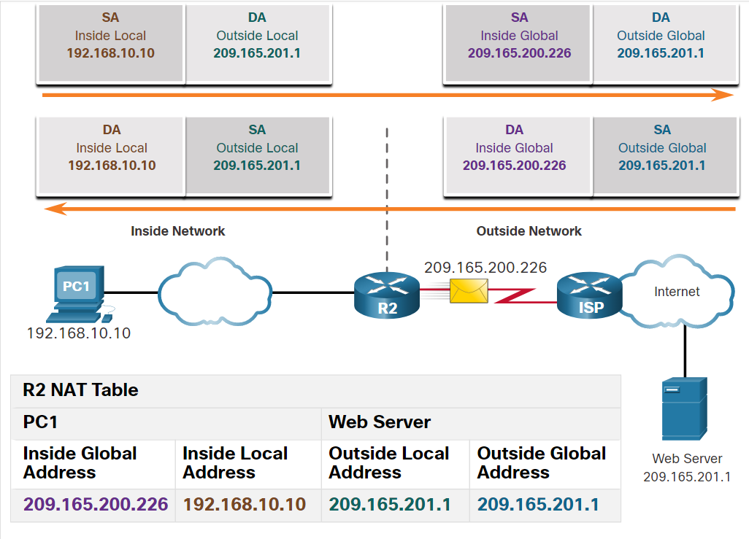

Slide 7
QUIZ

Slide 8
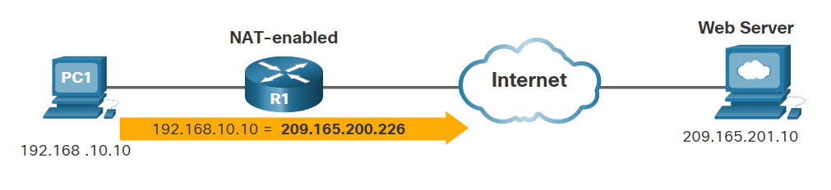
Question: What type of NAT address is the IP address of PC1 (i.e., 192.168.10.10)?
Outside Local
Inside Local
Outside Global
Inside Global

Slide 9
Question: Refer to the exhibit. What type of NAT address is the IP address of the Web Server (i.e., 209.165.201.10)?
Outside Local
Inside Local
Outside Global
Inside Global

Slide 10
Dynamic NAT
Configure pool for dynamic NAT using ACLs
access-list [number] permit [network address] [wildcard mask]
Configure a pool of NAT addresses
ip nat pool [name] [available addresses] netmask [subnet mask]
Associate ACL with NAT pool
ip nat inside source list [number] pool [name] [overload]
Configure NAT on interfaces
ip [desired interface]
ip [inside/outside]
Verify NAT configuration
show ip nat translation

Slide 11
Static NAT
enable
configure terminal
ip nat inside source static [inside local address] [outside global address]
ip [desired interface]
ip nat [inside/outside]
show ip nat translation

Slide 12
LETS PRACTICE

Slide 13
Question: True or False? A side effect of NAT is that it hides the inside local IP address of a host from the outside network.
True
False

Slide 14
Question: True or False? With NAT overload, each inside local IP address is translated to a unique inside global IP address on a one-for-one basis.
True
False

Slide 15
THANK YOU!

